Slide 1

Terrain classification using 3D optical tactile sensor
A machine learning approach
Jiader Chou

Slide 2
Overview
Background
Goals of the thesis
Implementation
Robot
Enviroment setup
Segmentation of sensor data
Feature sets
Evaluation
Results and further improvement
Conclusion
Future work

Slide 3
Background
Terrain classification
Sensors
Tactile is one of the most informative

Slide 4
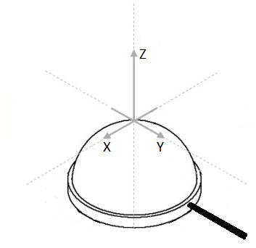
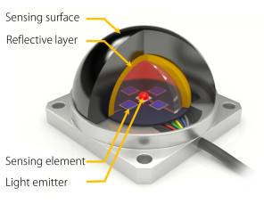
3D optical tactile sensor
Measuring light intensity
High sensitivity, small size, light weight and low detection time

Slide 5
Goals of the thesis
Evaluate 3D optical tactile sensor for the terrain classification problem
Investigating and developing a reliable approach for data processing, preprocessing, feature selection, and classification for the presented sensor.

Slide 6
Implementation
Robot
Enviorment setup
Segmentation of sensor data
Feature sets
Evaluation of the sensor

Slide 7
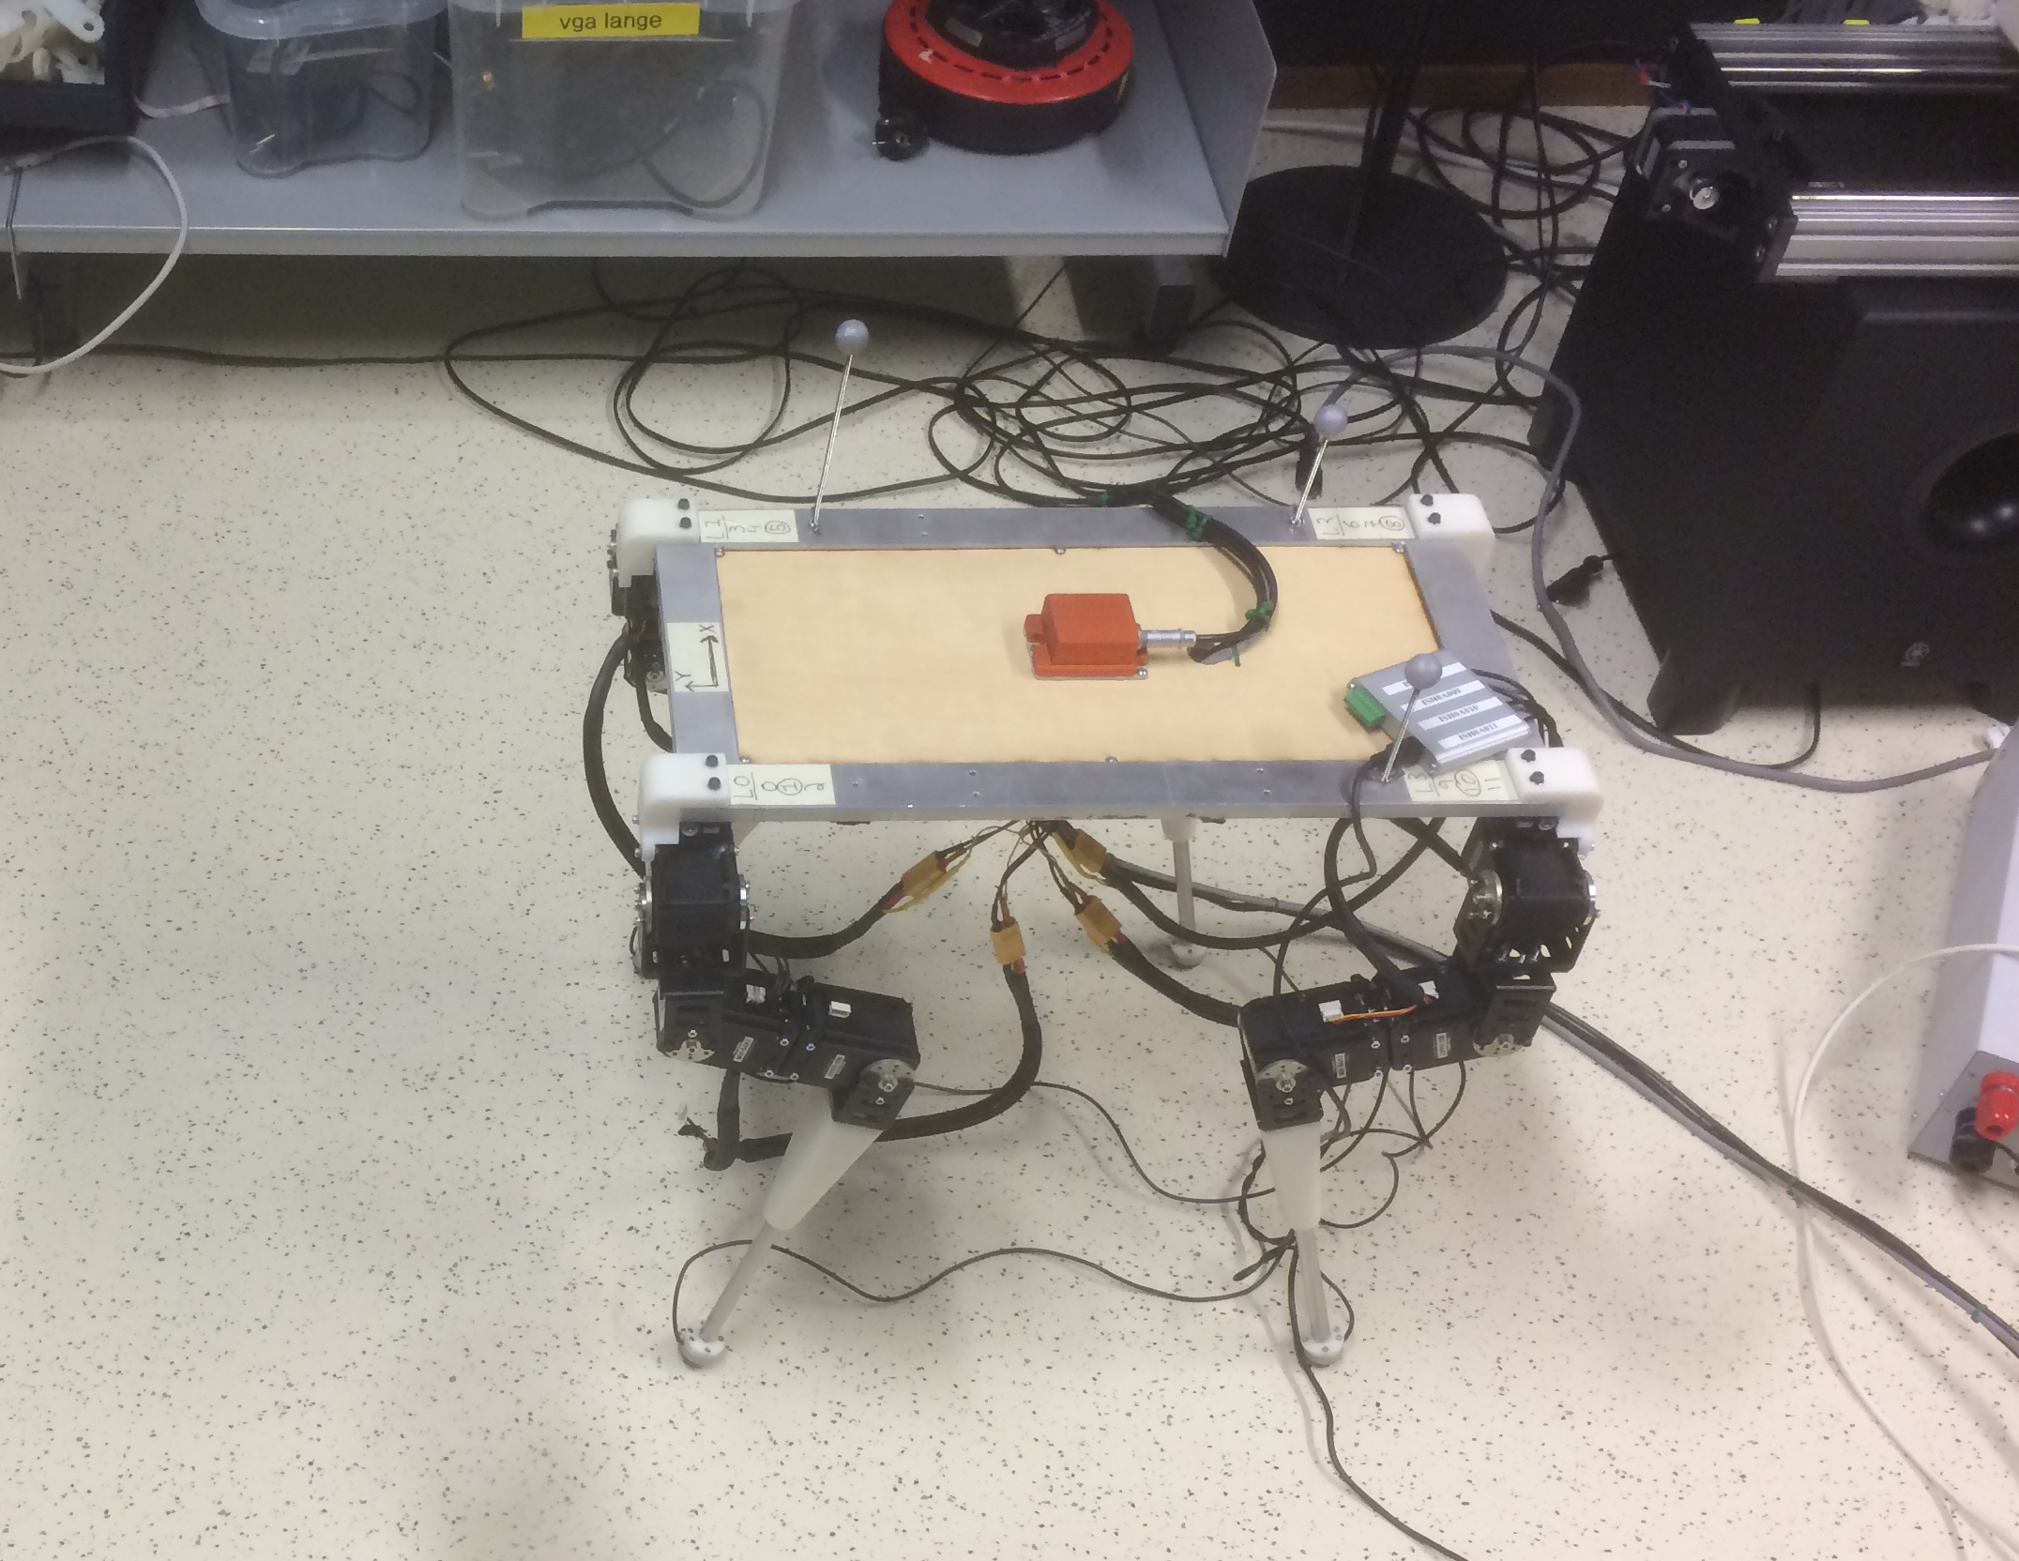
Robot

Slide 8
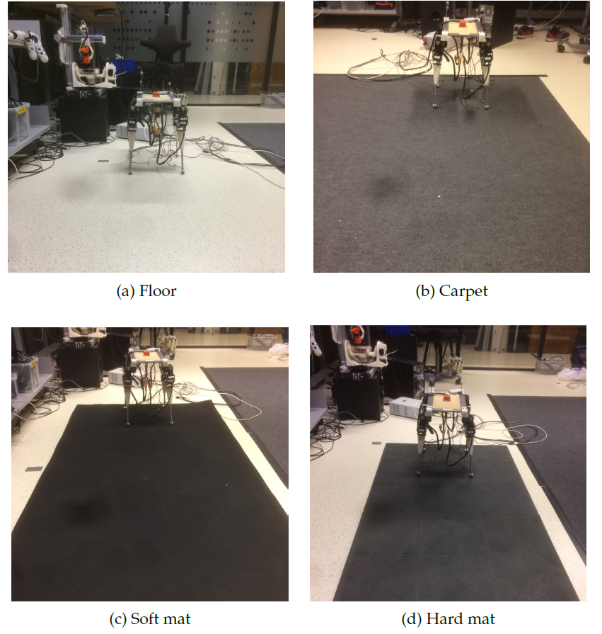
Enviroment setup

Slide 9
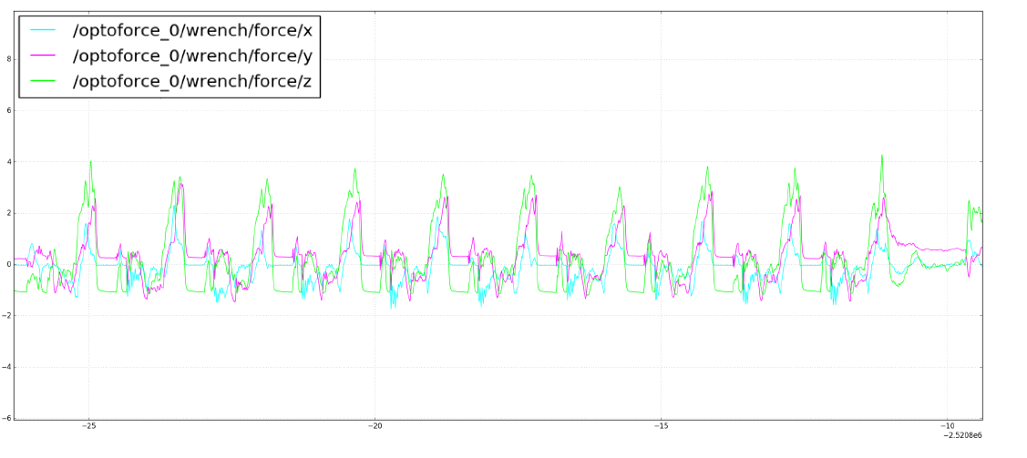
Segmentation of sensor data

Slide 10
Feature sets
Set one
Raw data
Set two
Statistical features in the time domain; max, min, mean, variance, skewness, kuortosis, standard deviation
Set three
Complete frequency domain
Set four
Statistical features in the frequency domain; max, min, mean, variance, skewness, kuortosis, standard deviation, energy
Set five
Set two and four

Slide 11
Classifiers
Neural network
Naive Bayes
SVM
Decision tree
KNN

Slide 12
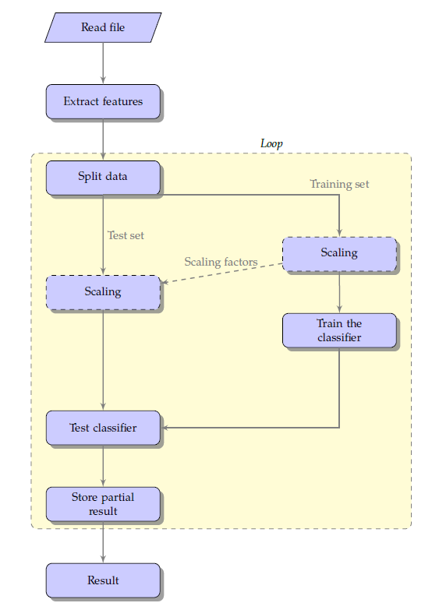
Test machine learning model

Slide 13
Evaluation
Find the best approach
Test the implementation
Integrate feature selection
Test on new data set
Hyperparameter tuning
Investigate the real-time implementation
Using the best approach to test the transistion between two terrains
Investigate the other sensor
Using training data from front left foot of the robot to predict sensor data from right front foot

Slide 14
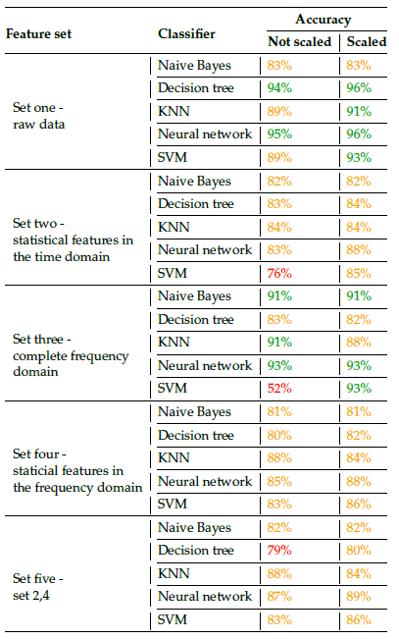
Results

Slide 15
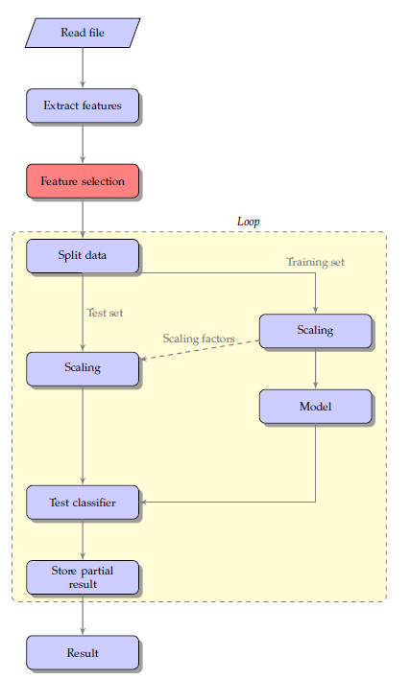
Integrating feature selection

Slide 16
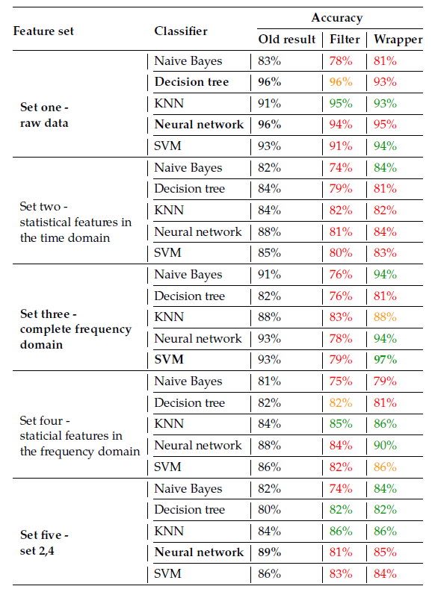
Results

Slide 17
Test on new data set
Feature set | Classifier | Feature selection | Current result
Set three | SVM | RFE (wrapper) | 97%
Set one | Neural network | None | 96%
Set one | Decision tree | RFLV (filter) | 96%
Set one | Decision tree | None | 96%
Set five | Neural network | None | 89%

Slide 18
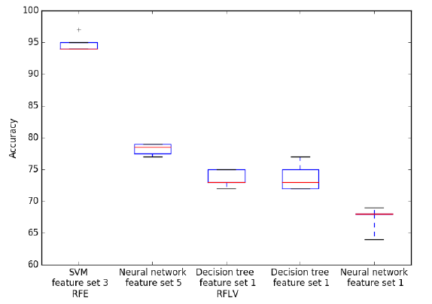
Results

Slide 19
Hyperparameter tuning
Grid search
SVM
Kernel
C
Neural network
Neurons
Binary representation

Slide 20
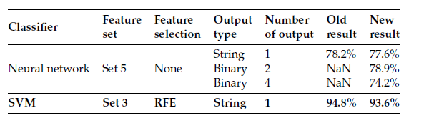
Results

Slide 21
Classification in real-time
Floor to carpet
Hard mat to floor
Hard mat to soft mat
Soft mat to hard mat
Soft mat to carpet

Slide 22
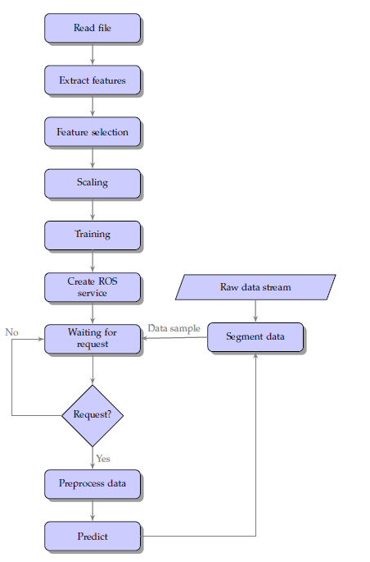
Real-time implementation

Slide 23
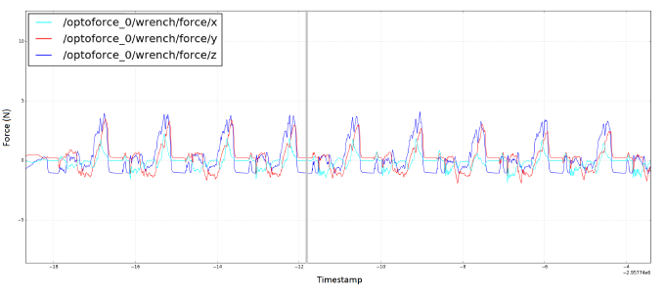
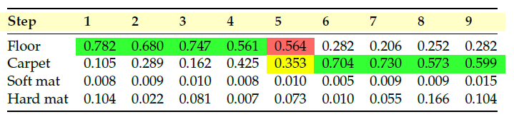
Floor to carpet

Slide 24
Summary
Overall accuracy of 85.3%
Low probability step before transistion
Detection of new terrain

Slide 25
Investigate the other sensor
Using training data from front left foot of the robot to predict sensor data from right front foot

Slide 26
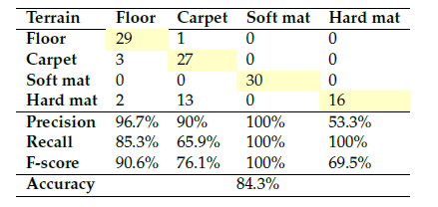
Results

Slide 27
Conclusion
The results confirm that the 3D optical tactile sensor is suitable to use for terrain classification
The best approach is using complete frequency domain with SVM

Slide 28
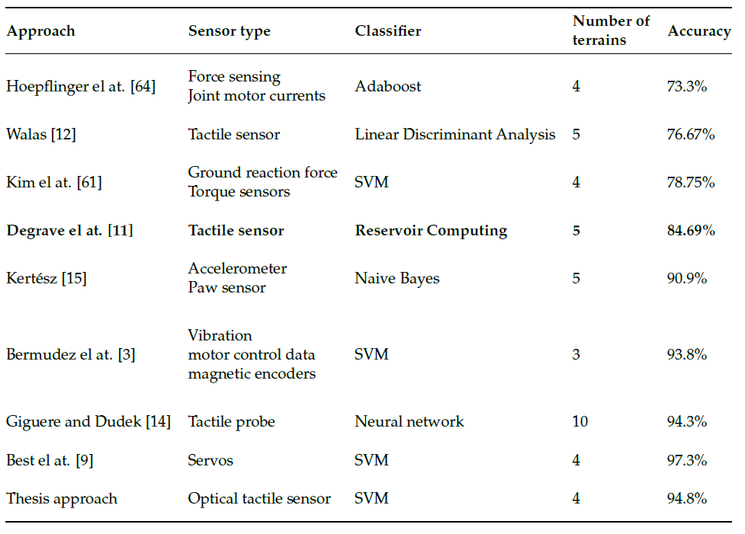
Compared to earlier work

Slide 29
Future work
Features of the terrain itself such as hardness and friction are not analyzed directly
Include rougher surfaces
Incorporating all four sensor
Utilized with other sensors
Unsupervised learning
Gait changing on different terrains

